Slide 1
7 segment display
Aya mohamed sayed sec 1

Slide 2
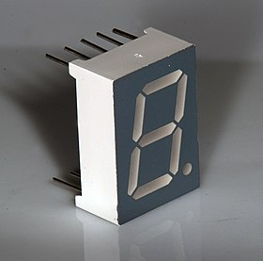
7 segment display
1-A seven-segment display is a form of electronic display device for displaying decimal numerals that is an alternative to the more complex dot matrix displays. 2-Seven-segment displays are widely used in digital clocks, electronic meters, basic calculators, and other electronic devices that display numerical information. The seven segments are arranged as a rectangle of two vertical segments on each side with one horizontal segment on the top, middle, and bottom. Often the rectangle is oblique (slanted), which aids readability.[citation needed] In most applications, the segments are of nearly uniform shape and size (usually elongated hexagons, though trapezoids and rectangles can also be used), though in the case of adding machines, the vertical segments are longer and more oddly shaped at the ends in an effort to further enhance readability. The seven elements of the display can be lit in different combinations to represent the Arabic numerals.

Slide 3
Character of 7 segment
The segments are referred to by the letters A to G, where the optional decimal point (an "eighth segment", referred to as DP) is used for the display of non-integer numbers. A single byte can encode the full state of a 7-segment-display including the decimal point. The most popular bit encodings are gfedcba and abcdefg. In the gfedcba representation, a byte value of 0x06 would turn on segments "c" and "b", which would display a "1".

Slide 4
Binary 7 segment to dicimal
The numerical digits 0 to 9 are the most common characters displayed on seven-segment displays. The most common patterns used for each of these is:[18] Alternate patterns: The numeral 1 may be represented with the left segments, the numerals 6 and 9 may be represented without a "tail", and the numeral 7 represented with a 'tail':[19] In Unicode 13.0, 10 codepoints had been given for segmented digits 0–9 in the Symbols for Legacy Computing block, to replicate early computer fonts that included seven-segment versions of the digits.[20] The official reference shows the less-common four-segment "7". The characters as displayed by your browser:

